Slide 1
Pluralsight Training Discussion Session: Understanding Factor Analysis and PCA
Somu Palaniappan, Sr Data Scientist
Lingyu Li, Data Scientist
Yvonne Edmonds, Director, Data Scientist
Sept 2021

Slide 2

Meeting Agenda
Winning Pluralsight Training
Understanding Factor Analysis and PCA by Vitthal Srinivasan
https://app.pluralsight.com/library/courses/understanding-applying-factor-analysis-pca/table-of-contents
Journal club style discussion of training
Overview of training content
Use cases for McKesson
Pro’s and con’s of training
Additional information needed?
Questions to the audience
Comments/Questions form the audience
Sections
Introducing Factor Analysis & PCA – Yvonne
Understanding Factor Analysis & PCA – Somu
Implementing Factor Analysis & PCA in Excel & VBA, and R – Lingyu
Implementing Factor Analysis & PCA in Python – Yvonne
Results of August vote on Pluralsight Training Course

Slide 3
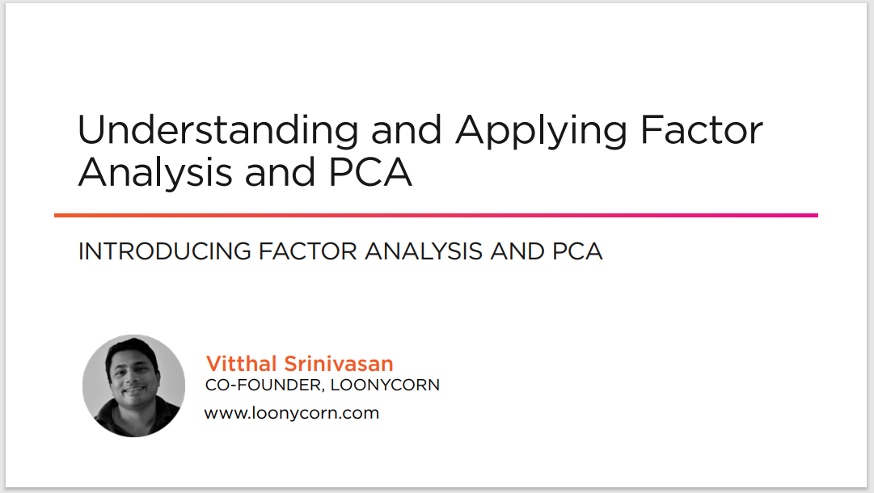
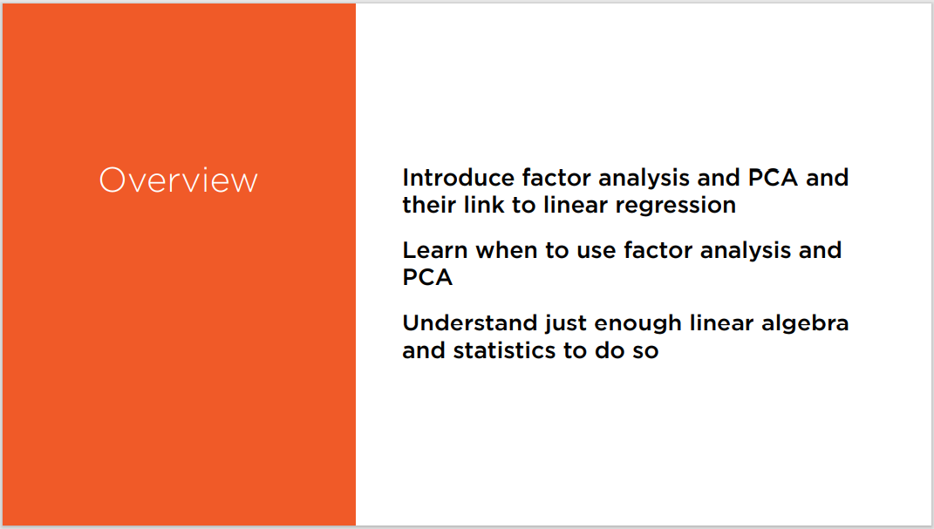
Introduction
Factor Analysis & PCA
Download the presentation slides and exercise files from the course webpage

Slide 4
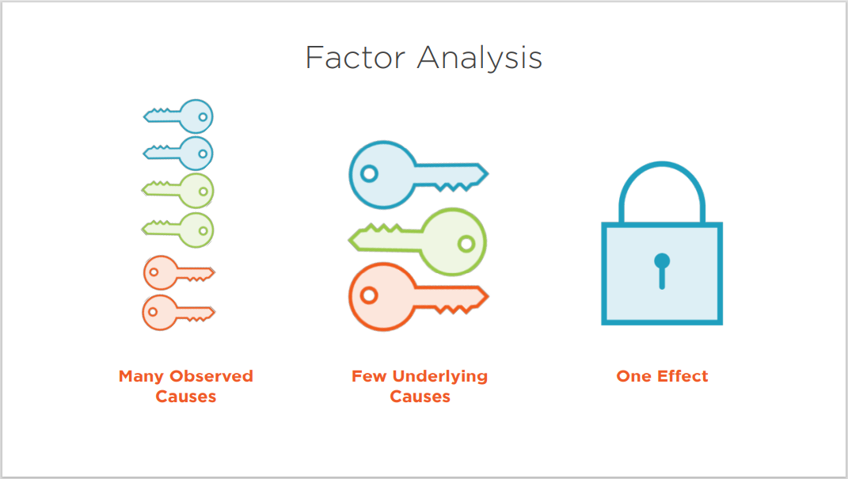
Linear Regression versus Factor Analysis
Introduction
Factor Analysis & PCA
Linear Regression
finds the best fit linear function that predicts a response variable value as a function of an explanatory variable(s) value
May have many explanatory variables
Factor Analysis
Understand the few underlying causes

Slide 5
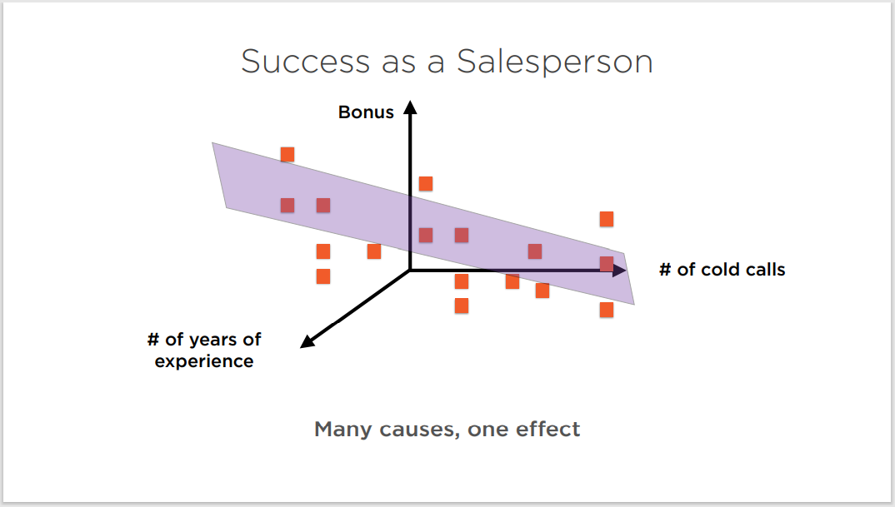
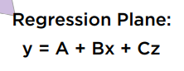
Example: Success as a Salesperson - Regression
Introduction
Factor Analysis & PCA
Response (dependent) variable
Bonus
Explanatory variables
# of years experience
# of cold calls
The purple shows our regression plane
Simple regression: 1 explanatory variable
Multiple regression: more than 1 explanatory variable
In simple (multiple) regression, we minimize the distance between the data points and the regression line (plane).

Slide 6
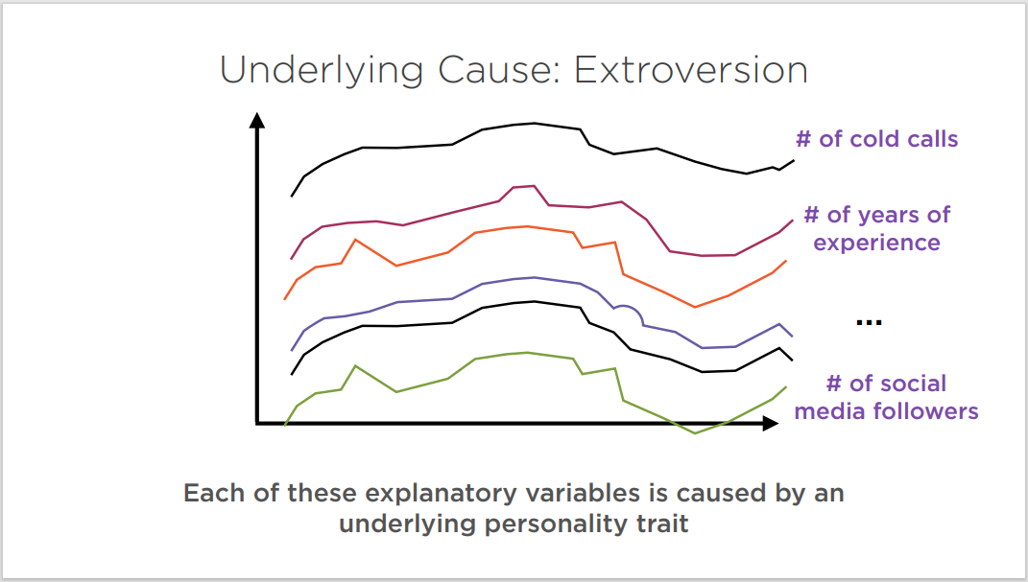
Example: Success as a Salesperson - Multicollinearity
Introduction
Factor Analysis & PCA
Multicollinearity: High collinearity between explanatory variables
Kitchen Sink regression: Leads to poor fits in regression models
There may be underlying factor that explains multicollinearity

Slide 7


Example: Success as a Salesperson – Factor Analysis
Introduction
Factor Analysis & PCA
Many explanatory variables are reduced to a few underlying causes

Slide 8
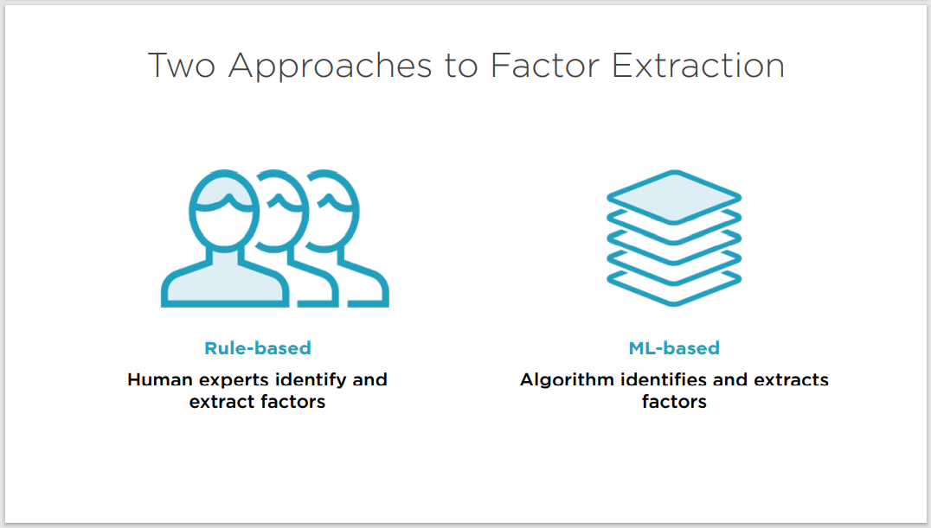
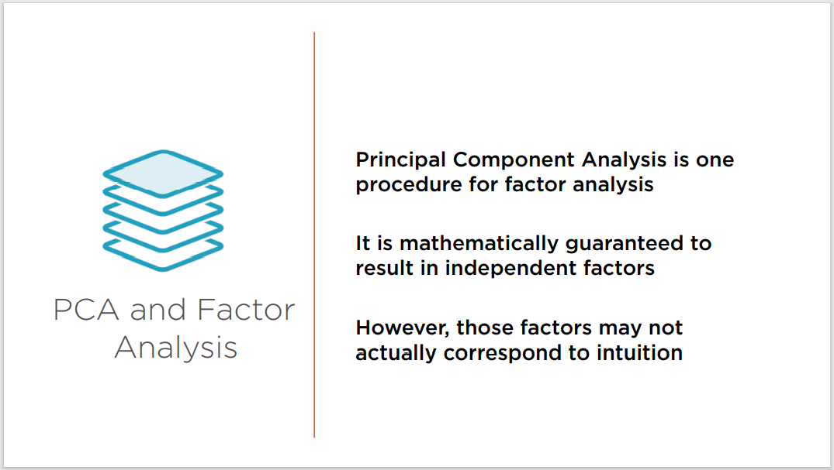
Approaches to Factor Analysis
Introduction
Factor Analysis & PCA

Slide 9
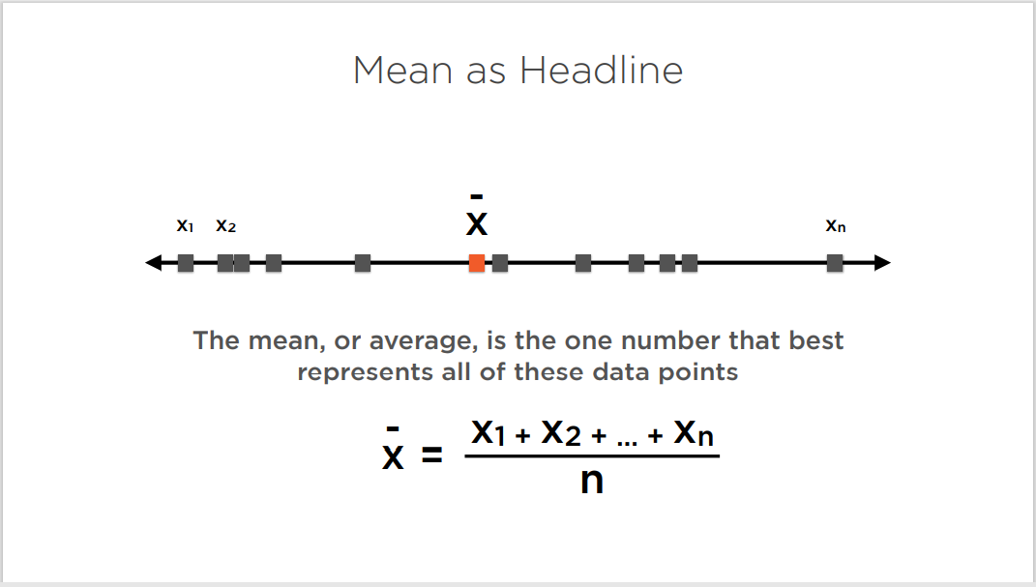
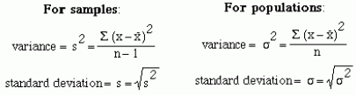
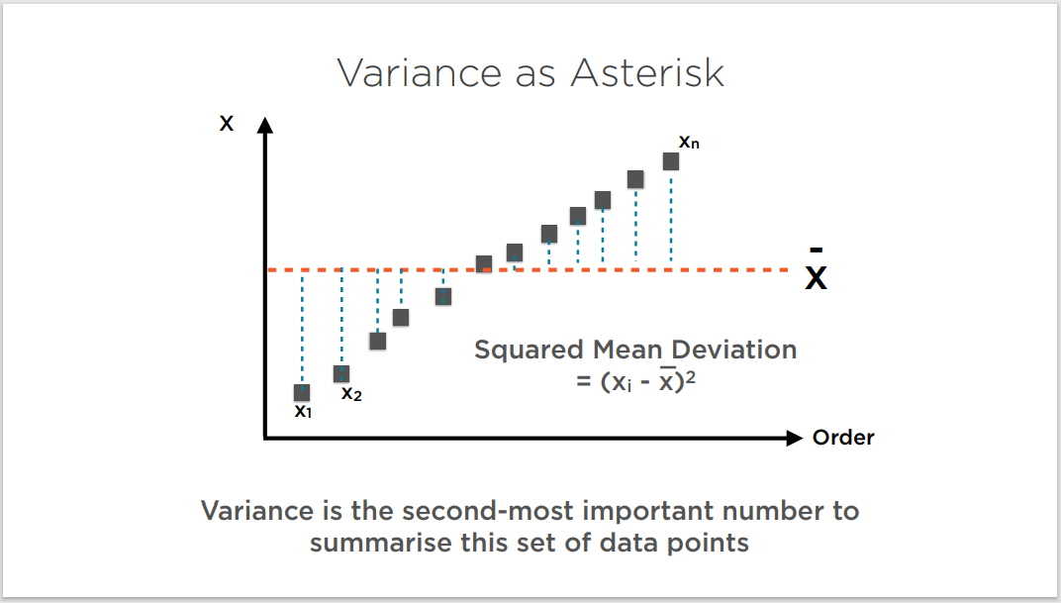
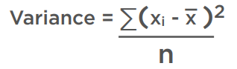
Background: Mean & Variance
Introduction
Factor Analysis & PCA
Mean describes the central tendency of a dataset
Variance is a measure of dispersion, how far points vary from the mean

Slide 10
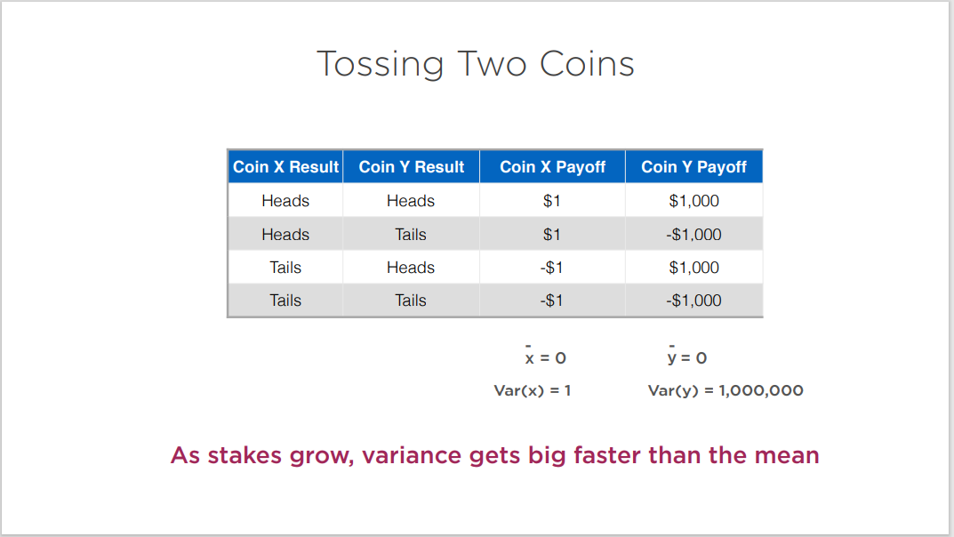
Coin Toss example
Introduction
Factor Analysis & PCA

Slide 11
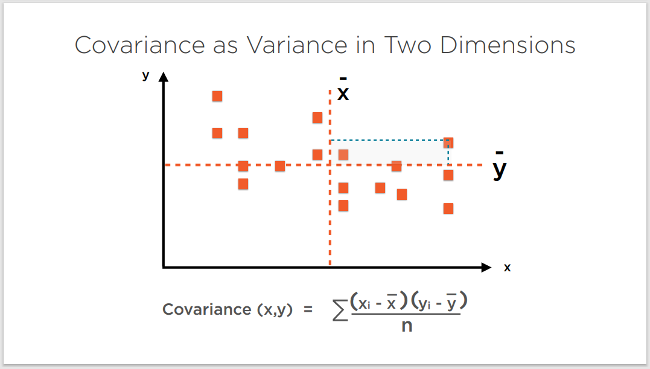
Covariance
Introduction
Factor Analysis & PCA
Covariance is a measure of the joint variability of two random variables
Data points in quadrants QI and QIII have positive covariance
Data points in QII and QIV have negative covariance
QII
QI
QIII
QIV

Slide 12
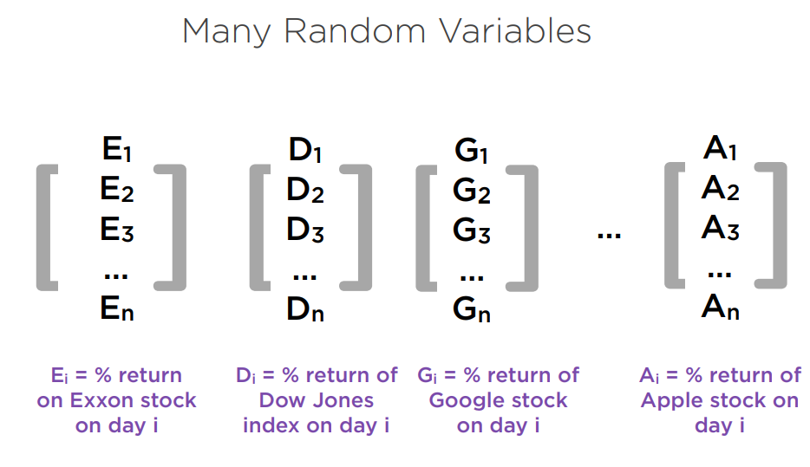
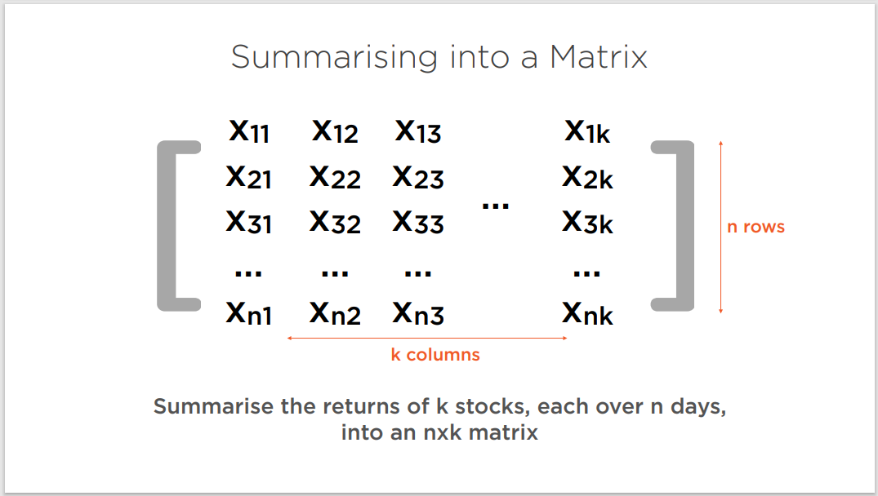
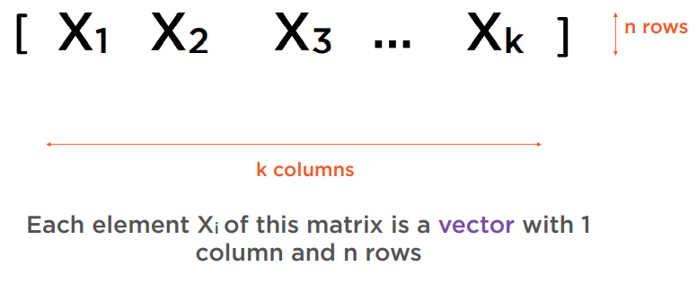
Matrix notation
Introduction
Factor Analysis & PCA
Stock example
X_{nk} is the return value for the k^{th} stock on day n

Slide 13
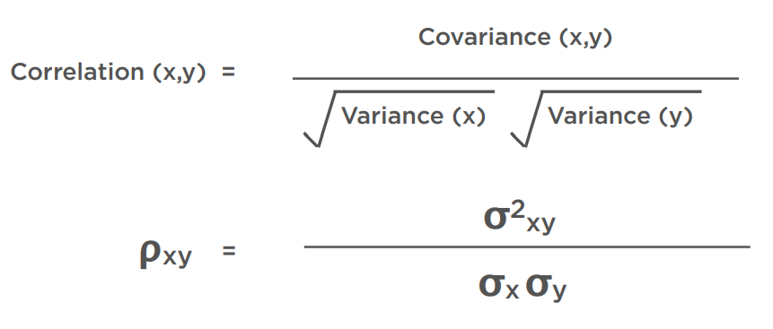
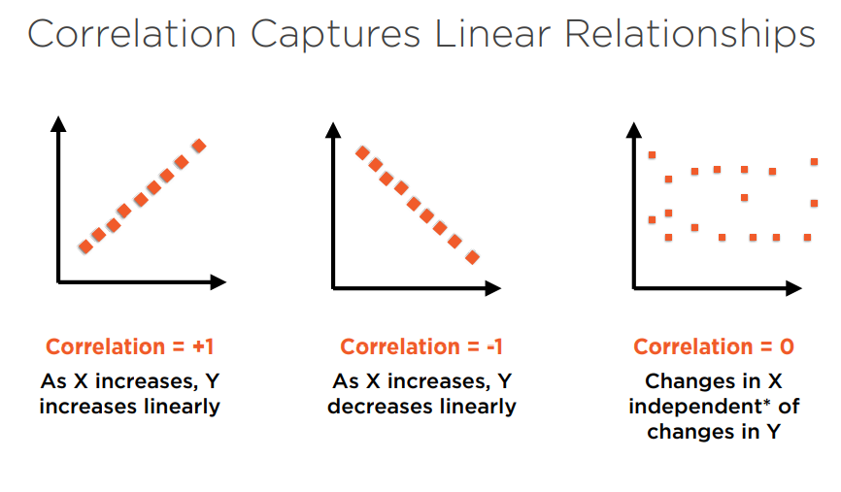
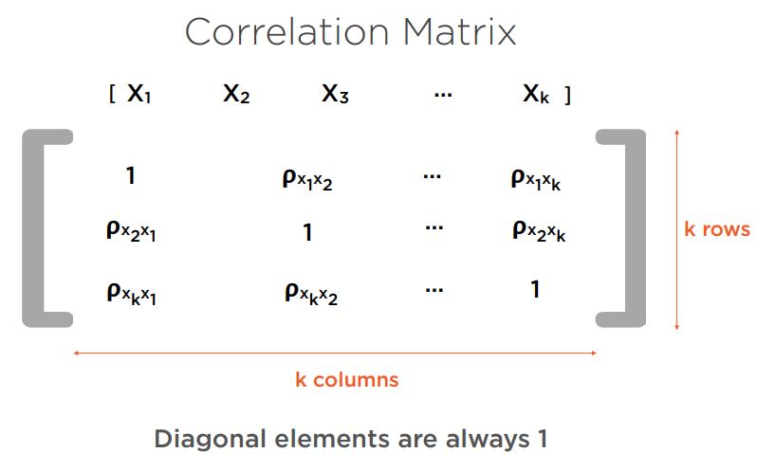
Correlation
Introduction
Factor Analysis & PCA

Slide 14

Discussion
Introduction
Factor Analysis & PCA
Content review
Use cases: latent factors of
MCK stock
MCK market share
supplier price changes
patient outcomes
Questions for audience
What are some use case from your business unit?
Likes/dislike of the training video?
Questions from audience

Slide 15
Overview
Understanding
Factor Analysis & PCA
Basic Linear Algebra Concepts (Not in Plural Sight lecture)
Understanding Basis Vectors
Linear Transformation & Matrix Multiplication
Determinant of a Transformation / Matrix
Eigen Value and Eigen Vector
Finding Eigen Value and Eigen Vector
PCA Intuition
PCA Derivation with example (Not in Plural Sight lecture)
PCA Components
PCA Total Variance
PCA Benefits
Dimensionality reduction
Latent Factor Identification
Missing Data Generation

Slide 16
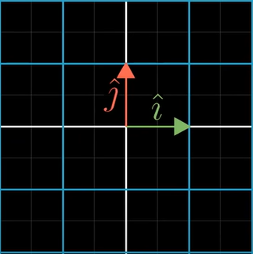
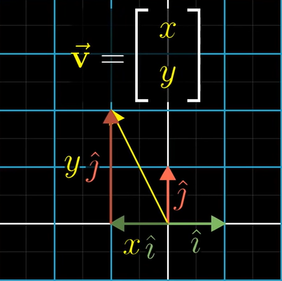
Understanding Basis Vectors
Understanding
Factor Analysis & PCA
(0,1)
(-1,2)
(1,0)
(0,1)
(1,0)
Basis Vectors
Always orthogonal (cannot represent one vector by another vector)
Unit length (norm = 1)
Spans the entire dimension.
To represent k dimensional space, we need set of k basis vectors
Any Vector V in that space can be represented in terms of its Basis vectors as show above

Slide 17
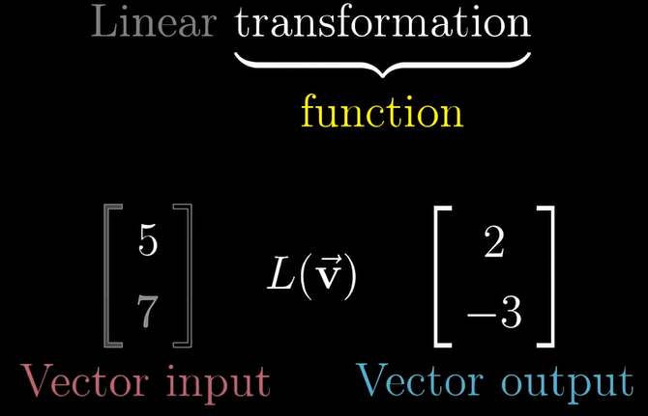
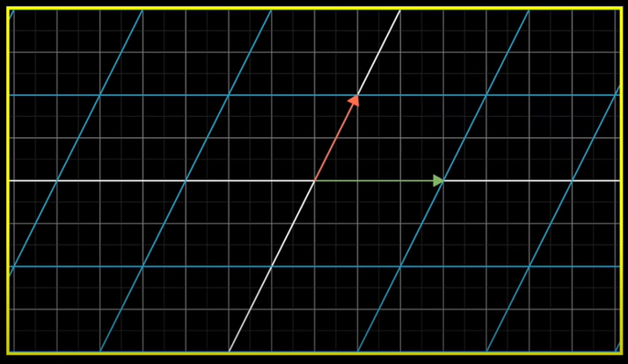
Understanding Linear Transformation
Understanding
Factor Analysis & PCA
Transformation is a function, that takes in Input vector and produces an Output vector.
Below transformation Example:
(1,0) → (3,0)
(0,1) → (1,2)

Slide 18

Understanding Linear Transformation
Understanding
Factor Analysis & PCA
Visually any such transformation is set to be linear if after transformation:
Origin remains same
Grid lines remains parallel and evenly spaced
Mathematically such transformation preserves vector addition and scalar multiplication.
f(u+v) = f(u) + f(v)
f(cu) = cf(u)

Slide 19
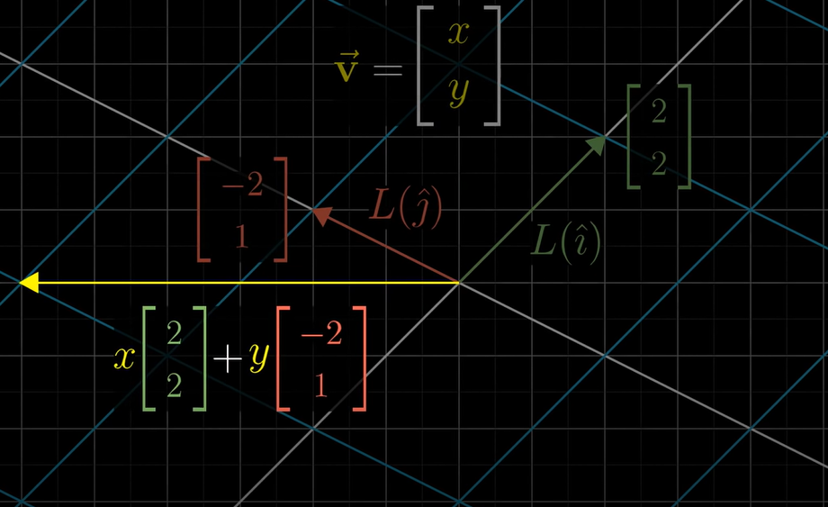
Understanding Linear Transformation
Understanding
Factor Analysis & PCA
If
(1,0) → (2,2)
&
(0,1) → (-2,1)
Where will vector (-1,2) land on transformed plane?
Ans: (-6,0)

Slide 20
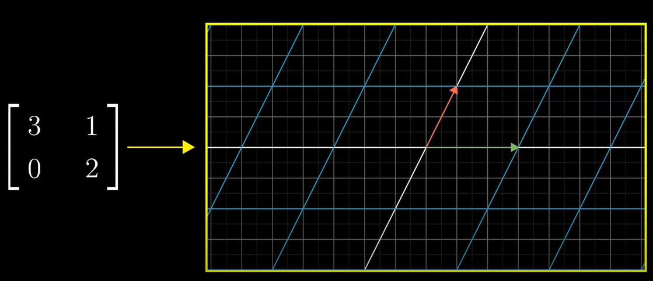
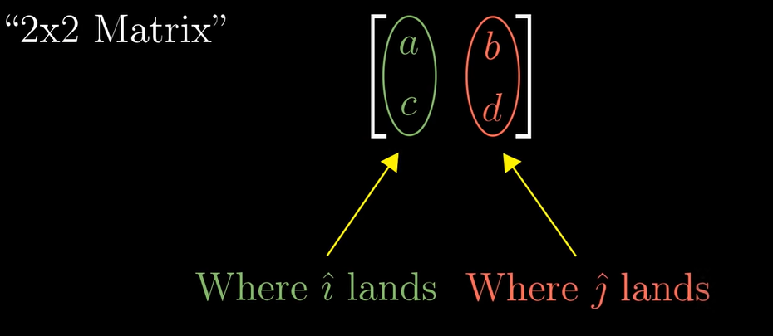
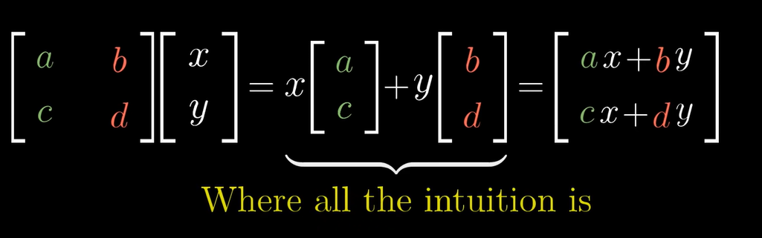
Linear Transformation is Matrix Multiplication
Understanding
Factor Analysis & PCA
Stack where every basis vector lands after transformation as column vector
Resulting Matrix contains all the information that is necessary to transform any given vector
Matrix multiplication of input vector with the transformation matrix produces transformed output vector

Slide 21
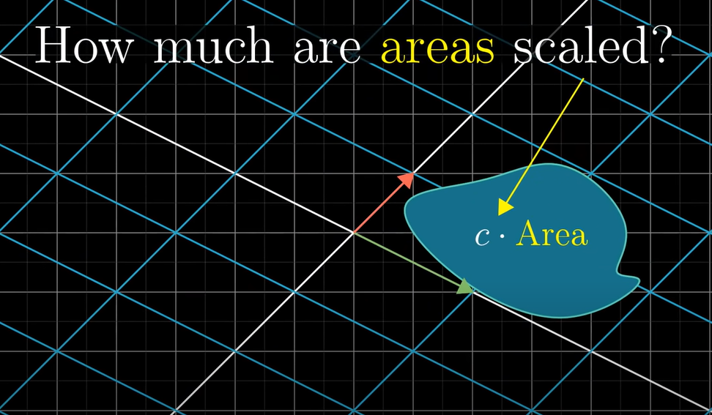
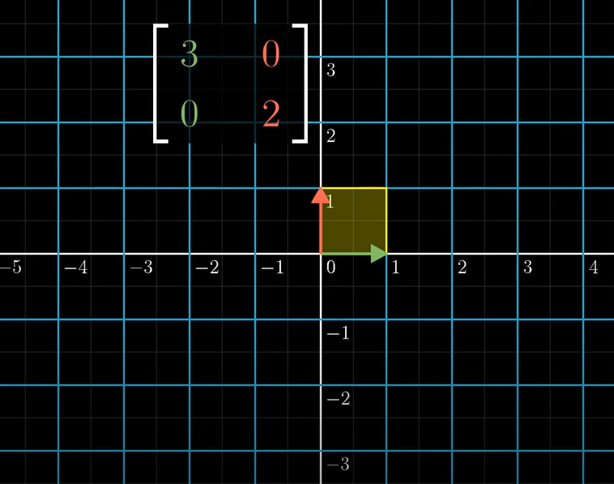
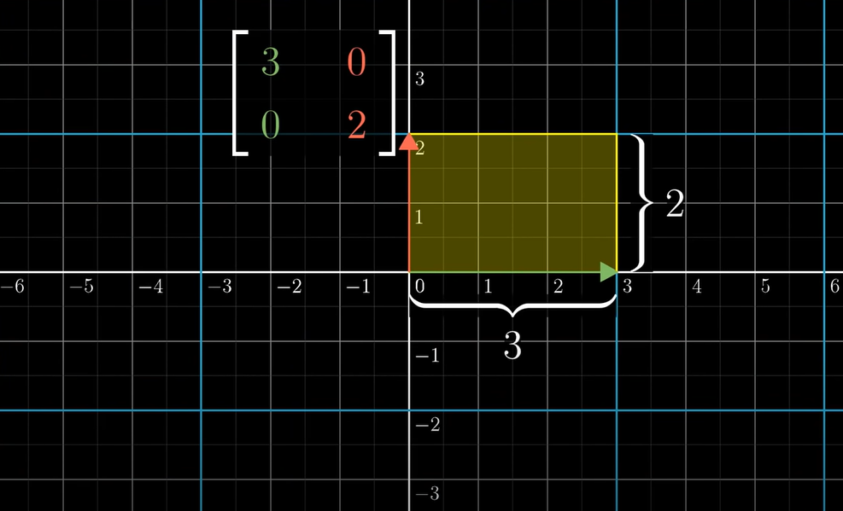
Determinant of Transformation (Matrix)
Understanding
Factor Analysis & PCA
Any Linear transformation stretches or squishes the space (changes the area)
It is very useful to understand exactly how much area increased or decreased after transformation.

Slide 22
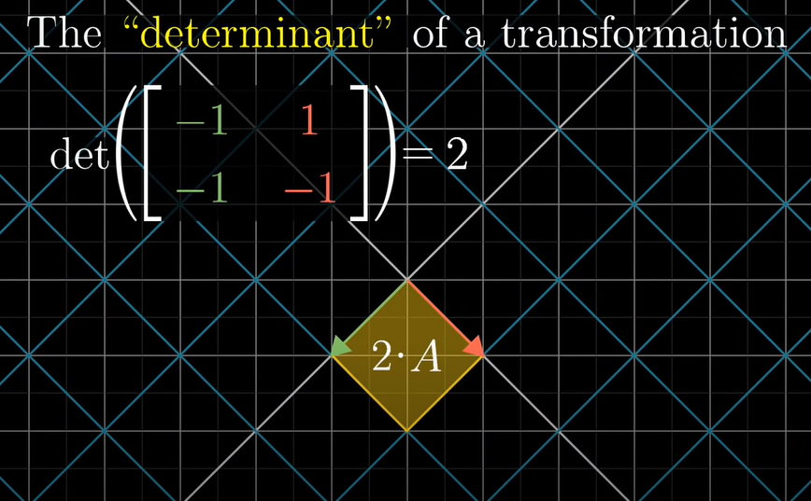
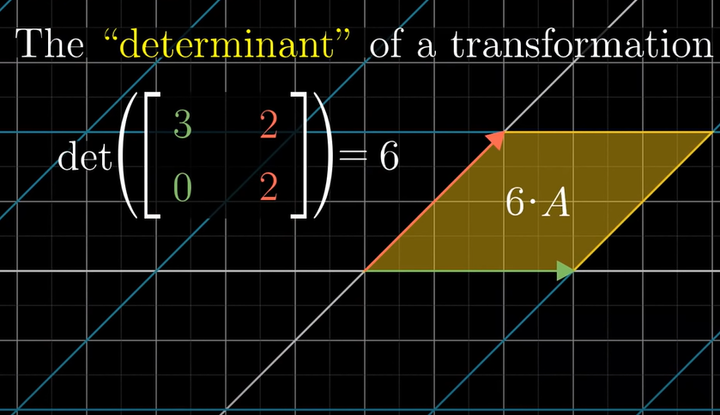
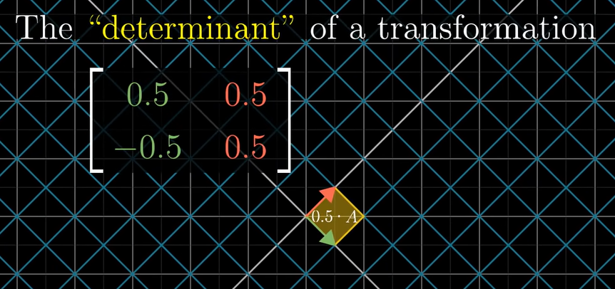
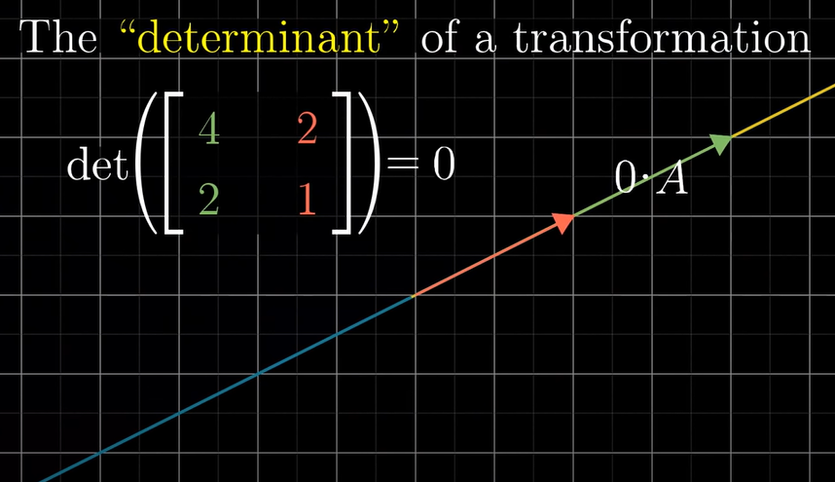
Example Transformation and Its Determinants
Understanding
Factor Analysis & PCA

Slide 23
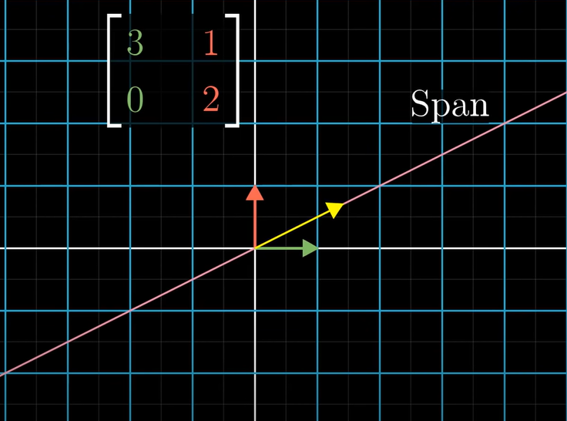
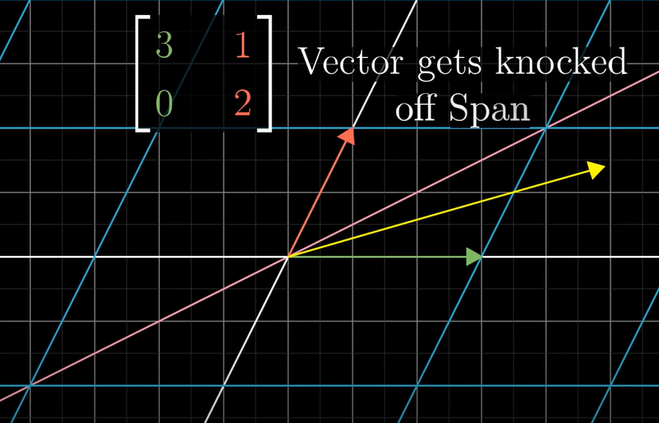
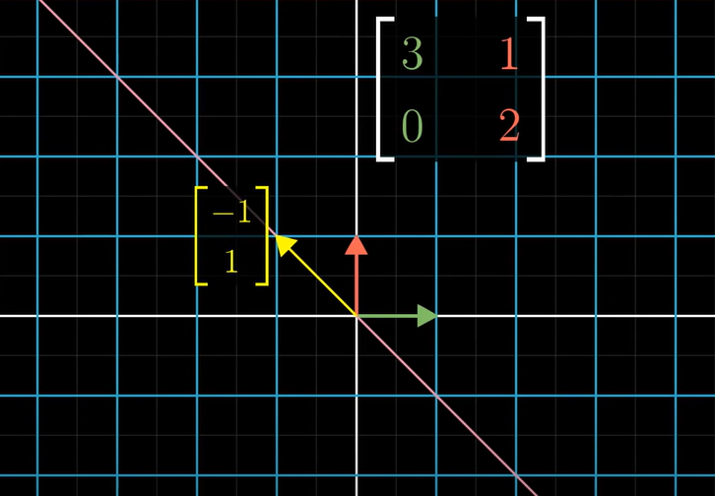
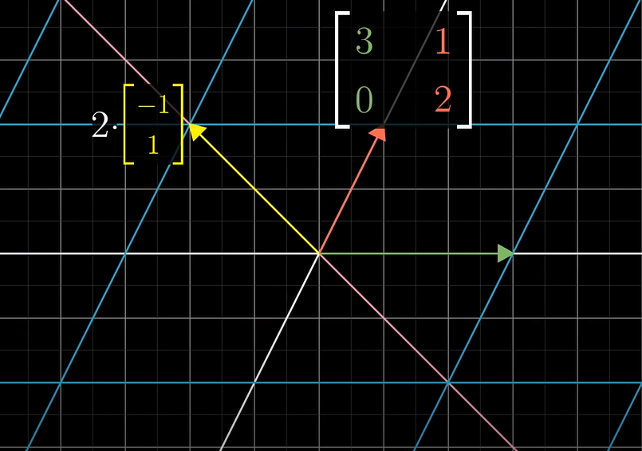
Eigen Value and Eigen Vectors
Understanding
Factor Analysis & PCA
Span of a vector: all possible vectors in same direction – Magnitude of the vector alone changes, direction remains same.
After transformation, most of the vectors gets knocked off span
Few vectors remains in its own span, just the magnitude changes.

Slide 24
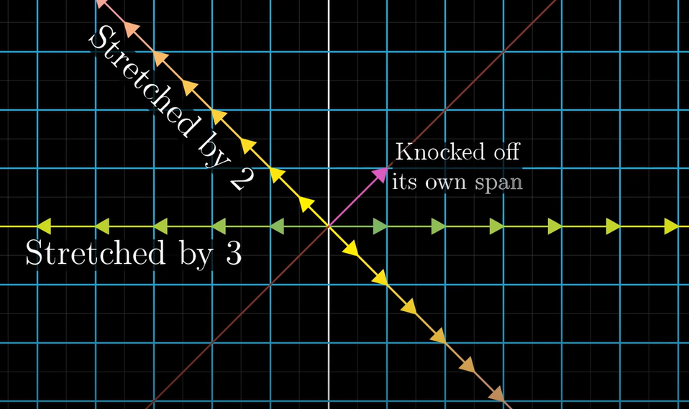
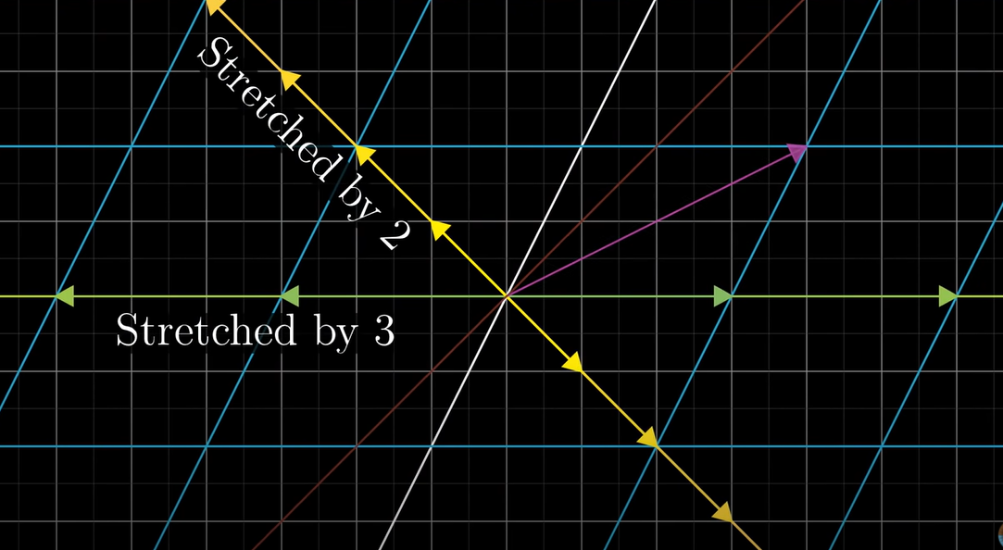
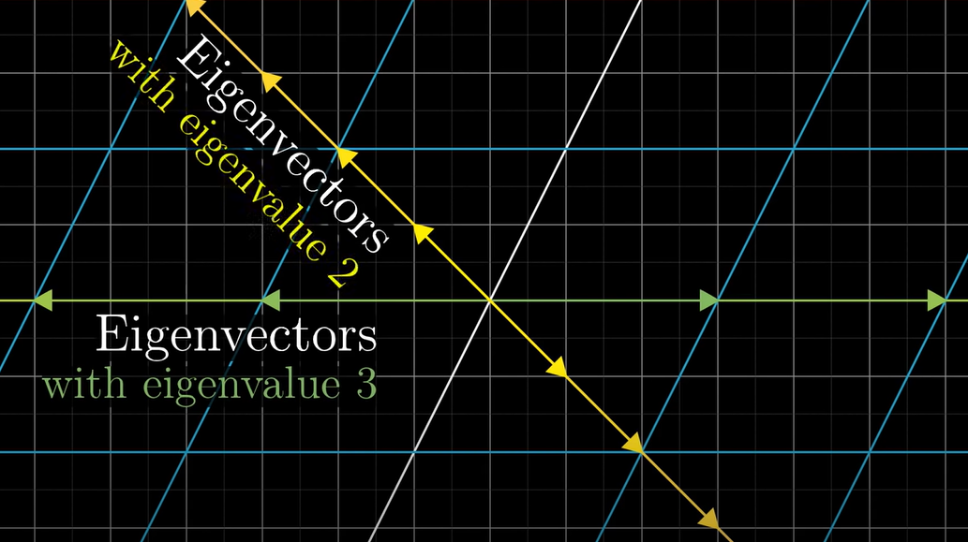
Eigen Value and Eigen Vectors
Understanding
Factor Analysis & PCA
Special vectors that stays in same span after transformation are called Eigen Vectors
Magnitude change for those eigen vectors are called eigen values.

Slide 25
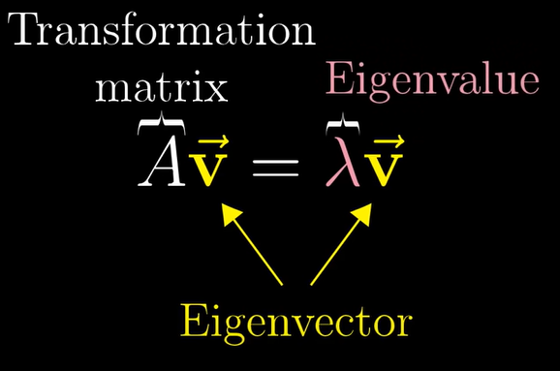
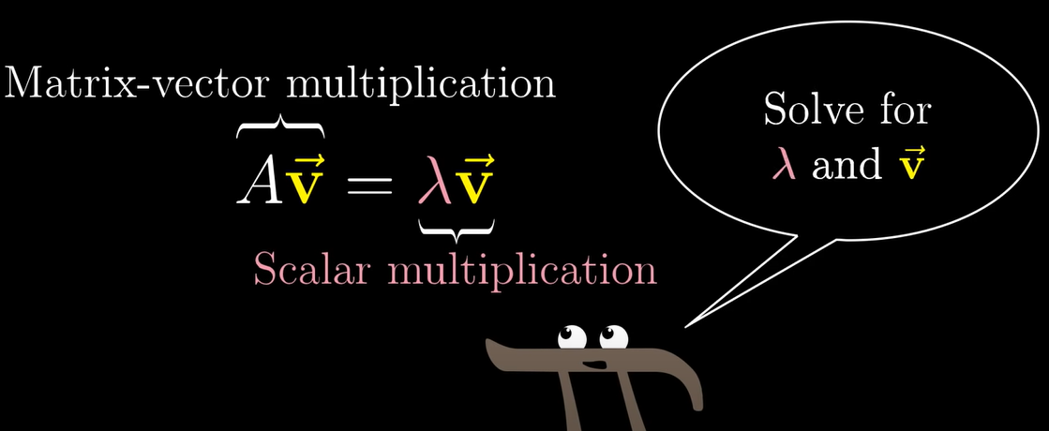
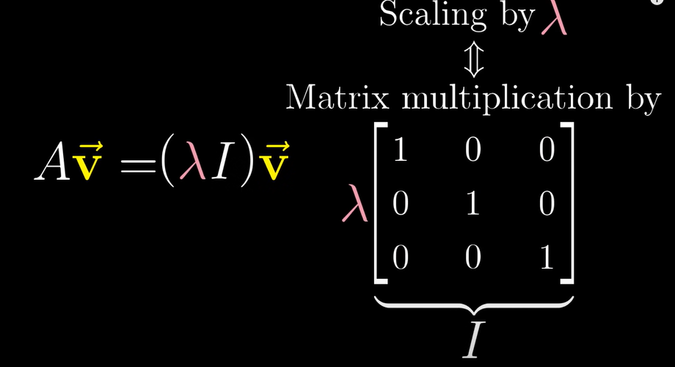
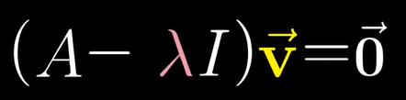
Finding Eigen Value and Eigen Vectors
Understanding
Factor Analysis & PCA

Slide 26
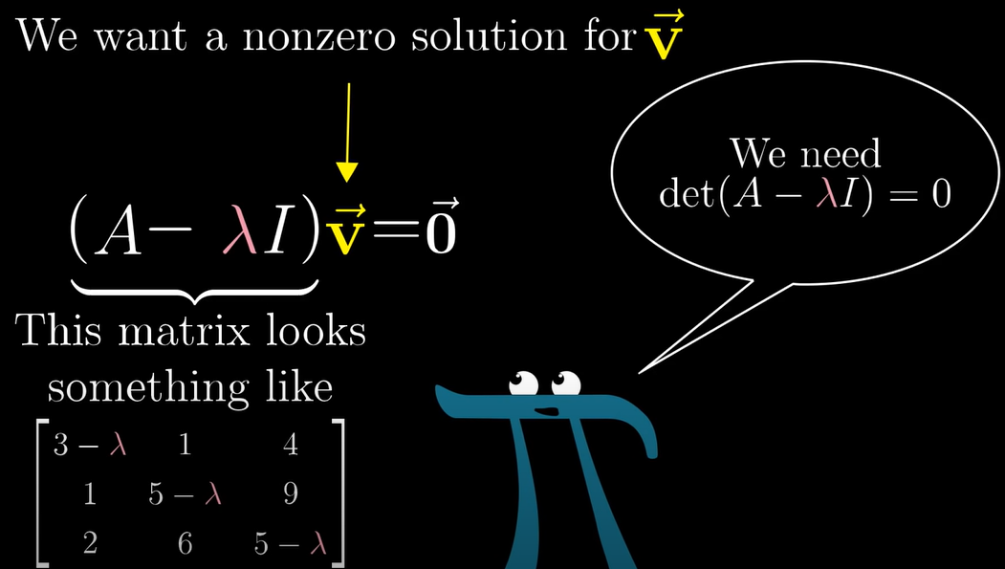
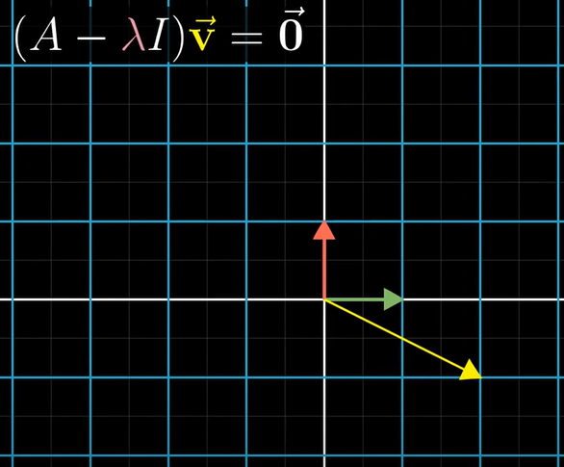
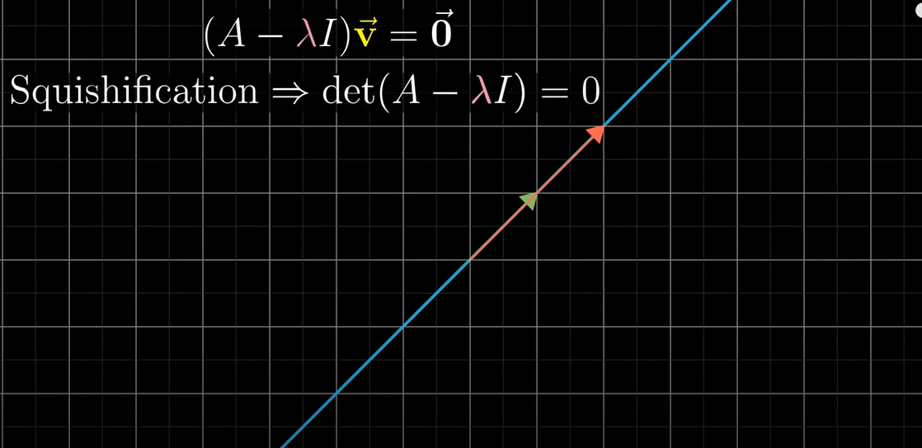
Finding Eigen Value and Eigen Vectors
Understanding
Factor Analysis & PCA
We are interested in some non-zero vector v, which becomes 0 vector after applying some linear transformation
As per previous discussion, this is possible only when Determinant of the transformation is 0

Slide 27
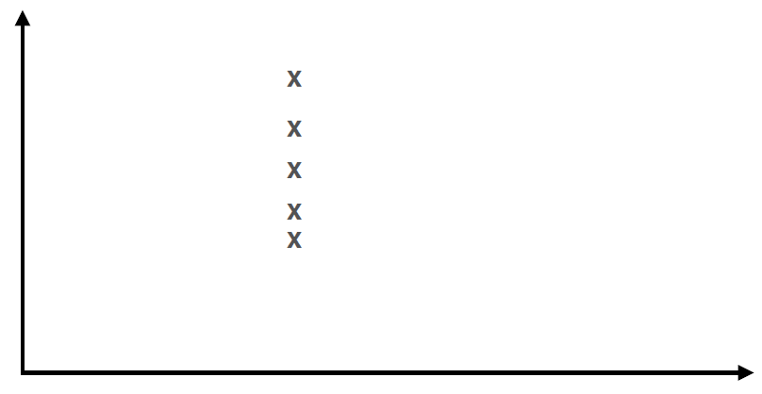


PCA Intuition
Understanding
Factor Analysis & PCA
Fig: A
Fig: B
Fig: C
Do we really need 2 dimension (x and y co-ordinate) to represent data in Fig A?
If we must choose only one dimension which choice is better? Why?
Choosing y co-ordinate is better because it preserves the distance information after projection (Fig B)
A projection where distances are minimized is a bad one – Information is lost

Slide 28




PCA Intuition
Understanding
Factor Analysis & PCA
Fig: A
Fig: B
Fig: C
2-dimensional data will have 2 principal components axis [like x and y axis]
The direction along which this variance is maximized is the first principal component axis of the original data
Find the next best direction, the second principal component axis, which must be at right angles to the first
Directions at right angles help express the most variation with the smallest number of directions
Fig: D
Fig: E

Slide 29


PCA Intuition
Understanding
Factor Analysis & PCA
Fig: A
Fig: B
Figure A represents the data in original co-ordinate system [x & y axis]
New x axis that captures the maximum variation in the data is in the direction PCA1
New y axis that captures the next best variation and right angle to PCA1 is PCA2
After projecting all the original data points with respect to PCA1 and PCA2 we get principal components
Once the data is in this form, it is easy to find and remove dimensions so that we lose very less information
Also, original data is highly correlated with each other, projected data is uncorrelated with each other

Slide 30




PCA Derivation
Understanding
Factor Analysis & PCA
In order to find the maximum or minimum of a function f(x) subjected to the equality constraint g(x) = 0 form the Lagrangian function

Slide 31

PCA Derivation - Example
Understanding
Factor Analysis & PCA

Slide 32

PCA Derivation – Example Finding Eigen Value and Eigen Vectors
Understanding
Factor Analysis & PCA
After finding Eigen values and Eigen vectors, you can use eigen vectors to transform input data into principal components in the transformed space using Matrix multiplication

Slide 33



PCA Components
Understanding
Factor Analysis & PCA
X is original data
F is projected data – called Principal components
V1 is the first eigen vector/ 1st principal component direction that captures most variation in given data, you can have k such dimensions
e1 is Eigenvalue of Eigen vector 1 = Variance(F1)
e1 > e2 > e3 ..
Greater the eigen value more important is the eigen vector

Slide 34



PCA Total Variance
Understanding
Factor Analysis & PCA
Total variance of the original data = Total variance of the project data
Variance of the projected data onto first principal component axis = eigen value 1 and so on..
% of total variance explained by each principal component axis is calculated by dividing its respective eigen value by total variance

Slide 35

PCA Benefits
Understanding
Factor Analysis & PCA

Slide 36



PCA Dimensionality Reduction
Understanding
Factor Analysis & PCA
Another advantage of PCA is, resulting data is uncorrelated.
It is easy to deal with uncorrelated random variables, math behind calculating co-variance is much simpler

Slide 37


PCA – Latent Factor Identification
Understanding
Factor Analysis & PCA
Experts trace back principal components to observable factors

Slide 38


PCA – Missing Data Generation
Understanding
Factor Analysis & PCA
Facebook’s IPO was in 2012, several years after other major tech companies
If we need to extrapolate and FB share data before 2012, we can generate those numbers using PCA

Slide 39
Reference & Discussion
Understanding
Factor Analysis & PCA
Reference:
3blue1brown youtube channel – Essence of Linear algebra lecture series:
https://www.youtube.com/playlist?list=PLZHQObOWTQDPD3MizzM2xVFitgF8hE_ab

Slide 40

Implementation (Excel)
Implementation
Factor Analysis & PCA
Implement PCA in Excel
Implement Eigen Analysis (in VBA)
Use Eigen Analysis to implement PCA in Excel
Apply linear regression
Excel Example walk through
Detect highly correlated variables: |correlation| > 0.3

Slide 41

Implementation (R)
Implementation
Factor Analysis & PCA
Implement PCA in R
Implement Eigen Analysis (build-in R function)
Compute Principal Components
Apply linear regression
R Example walk through

Slide 42
Additional Resources
Resources
NIST Engineering Statistics Handbook page on PCA
https://www.itl.nist.gov/div898/handbook/pmc/section5/pmc55.htm
Tutorial
Khan Academy Eigen-everything: https://www.khanacademy.org/math/linear-algebra/alternate-bases#eigen-everything
Andrew Ng YouTube lecture series on Dimensionality Reduction: https://youtu.be/Zbr5hyJNGCs
Wikipedia
https://en.wikipedia.org/wiki/Principal_component_analysis

Slide 43
Appendix

Slide 44

Why Does it Matter if Data is Normal?
Univariate Analysis
Normality
The normal distribution is popular because the of the central limit theorem, for a large sample size the mean of an IID random variable will be distributed as normal regardless of the population distribution.
NOTE: THE DATA IS FAKE!
Why might avg order quantity per pharmacy appear more normally distributed than total sales amount per pharmacy?
Pharmacies may service similar number of patients. Average order quantity is likely to be similar across all pharmacies..
However, pharmacies may have different specialties (Bx/Gx/Sx product mix). The total sales amount is not similar across pharmacies.
Nominal categorical variables such as survey responses will not have normal distributions. However, at ordinal variable such aa 1 to 10 rating could have a normal distribution.
Use case
I would like to compare two distributions (e.q. # of orders before and after a campaign, patient lab vital before and after treatment,…). Different comparison tests should be used based on whether your data is normal or not.
Explain why normal data is better for modeling. Determine if data should be transformed to improve normality prior to scaling in a model.
Determine if there is structure in the residuals for my model.
Plot a normal distribution over the plots

